Slide 1
Agenda
Give a small scenario
What is AppDynamics
Features and functions
AppDynamics at Pratt & Whitney
AppD Model
Licenses and monitoring
Dashboard
Process Based Approach
Next Steps

Slide 2

AppDynamics at Pratt & Withney
January 2025
Notes:
Audience:
When to use:

Slide 3
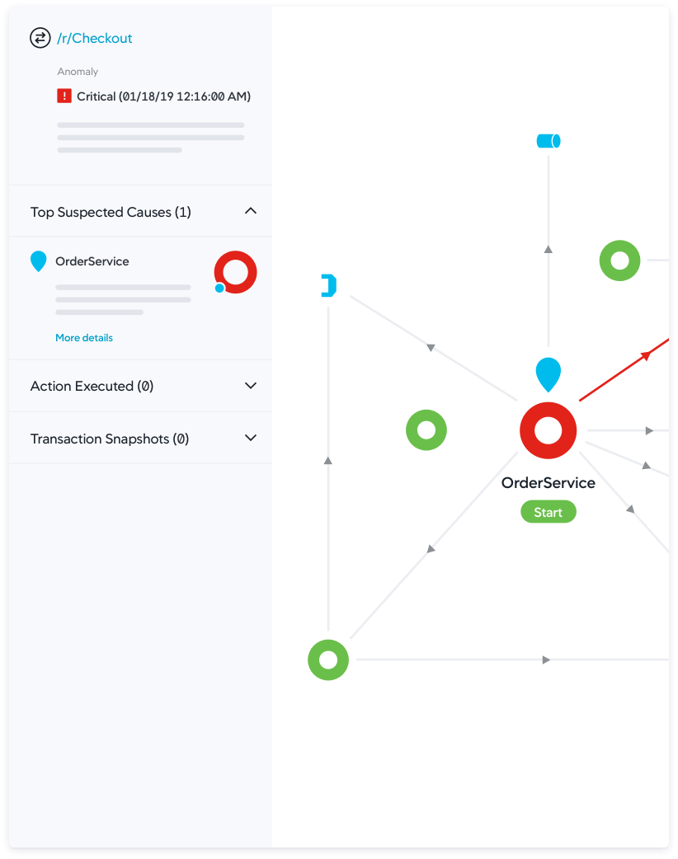
AppDynamics Features & Benefits
Data Collection:
AppDynamics Agents monitor your entire application ecosystem, collecting real-time performance data. The Controller visualizes this data and sends instructions to the agents.
Auto-Discovery & Mapping:
Automatically discovers traffic flow and creates dynamic topology maps to visualize performance across your application environment.
Digital Experience Monitoring:
Track user experiences with web, mobile, and synthetic monitoring to catch issues early. Monitor key metrics across devices, browsers, APIs, and services.
Business Transaction Monitoring:
Monitors critical user transactions like logins and checkouts, ensuring seamless performance for revenue-driving activities.
Anomaly Detection:
Automatically baseline performance and set alerts to detect and resolve issues before they impact users.
Root Cause Diagnostics:
Reduce mean time to resolution (MTTR) with actionable insights, allowing IT teams to prioritize and fix critical issues quickly.
Full-Stack Analytics:
Gain insights into key transaction data to drive better decisions and support digital transformation goals.
Custom Dashboards:
Easily create custom dashboards for full-stack visibility, now enhanced with ThousandEyes network intelligence.
Notes:
AppDynamics offers powerful application performance management features such as real-time performance monitoring, end-to-end transaction visibility, and code-level diagnostics. It uses AI-powered root cause analysis, dynamic baselines, and anomaly detection to quickly identify and resolve performance issues. With multi-cloud and container monitoring, user experience tracking, and DevOps integration, AppDynamics optimizes performance across complex environments. The key benefits include faster issue resolution, enhanced user satisfaction, reduced downtime, and actionable insights that link application performance to business outcomes, helping organizations improve both operational efficiency and business results.

Slide 4
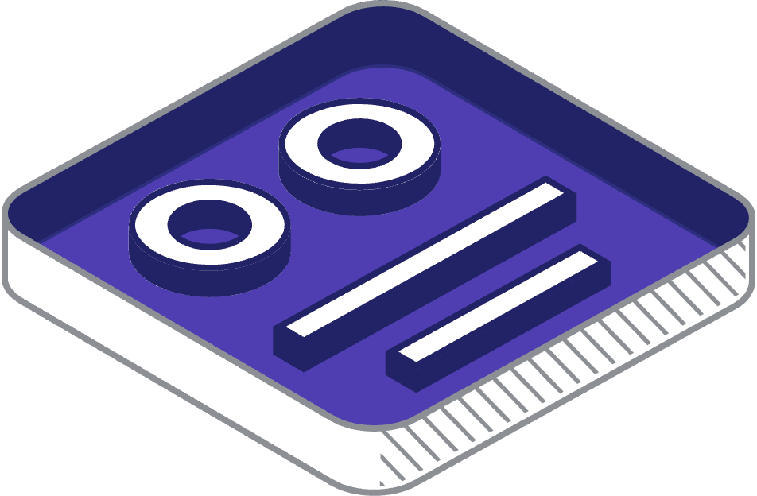
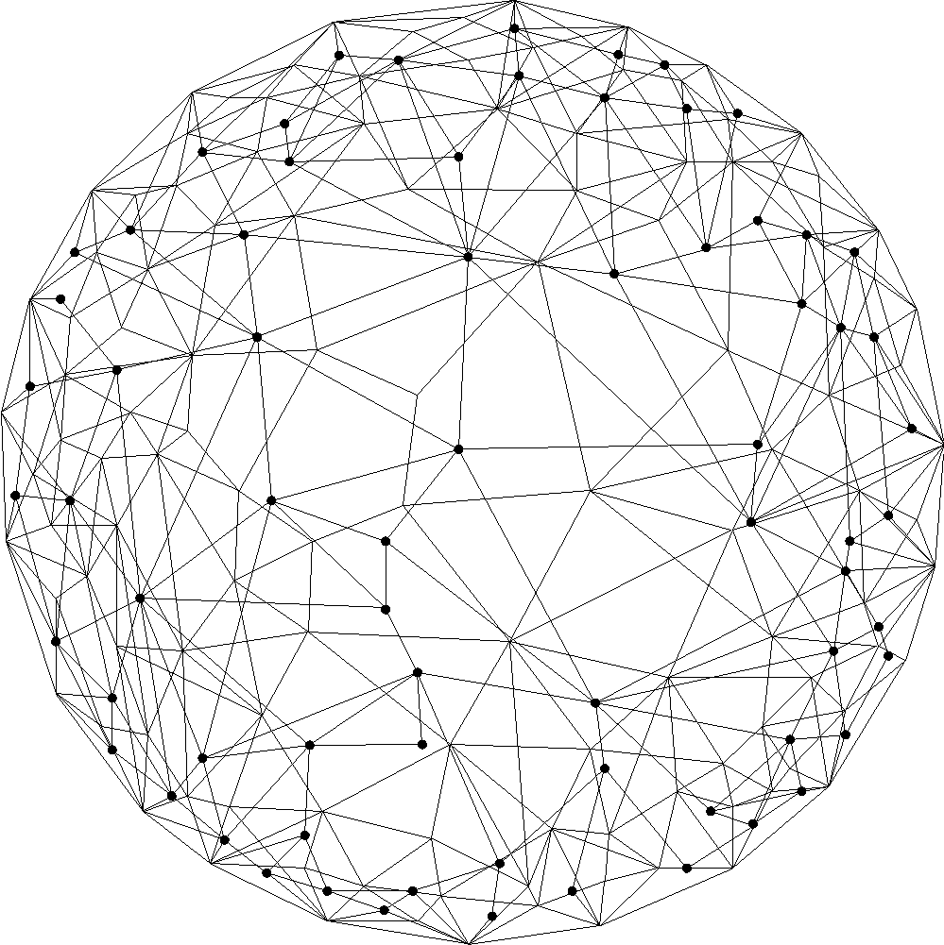
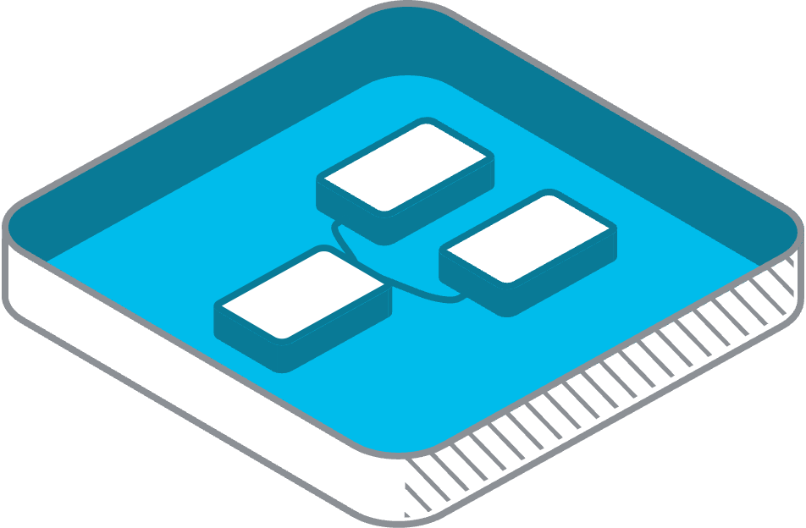






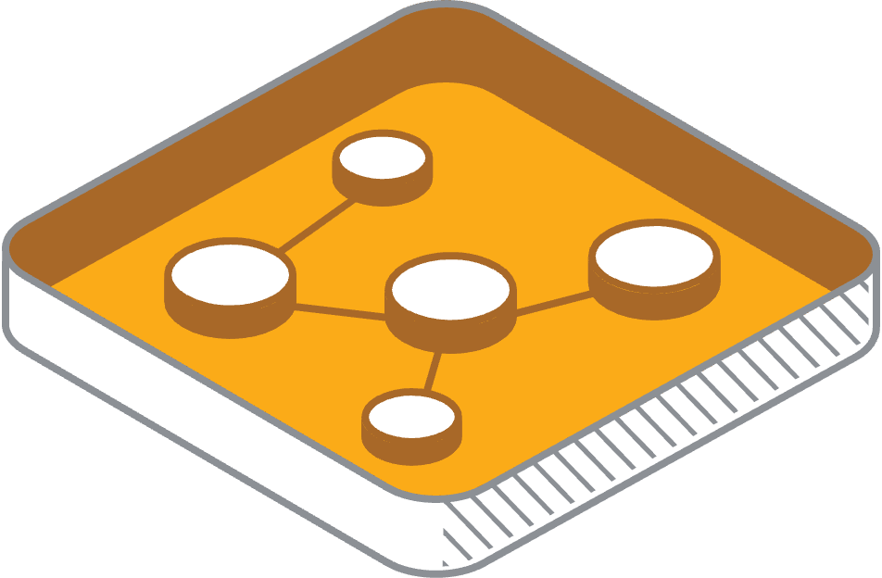
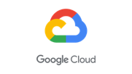
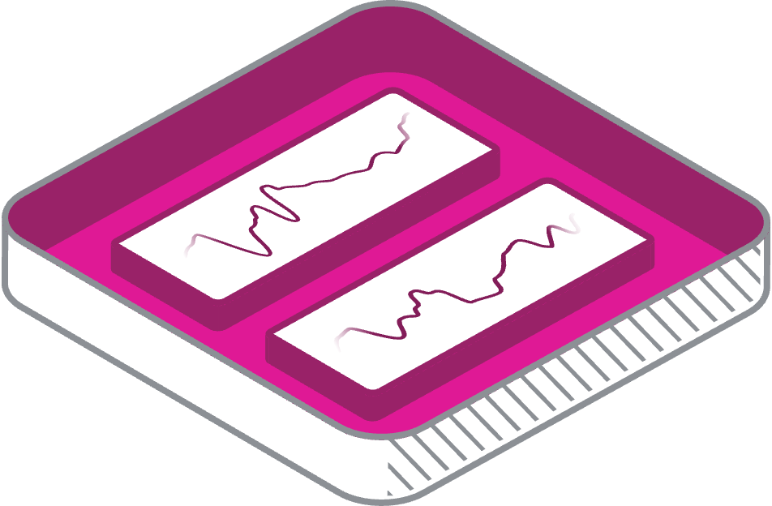




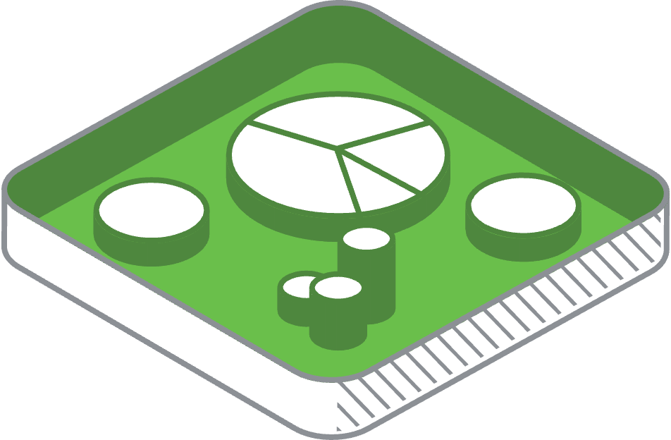




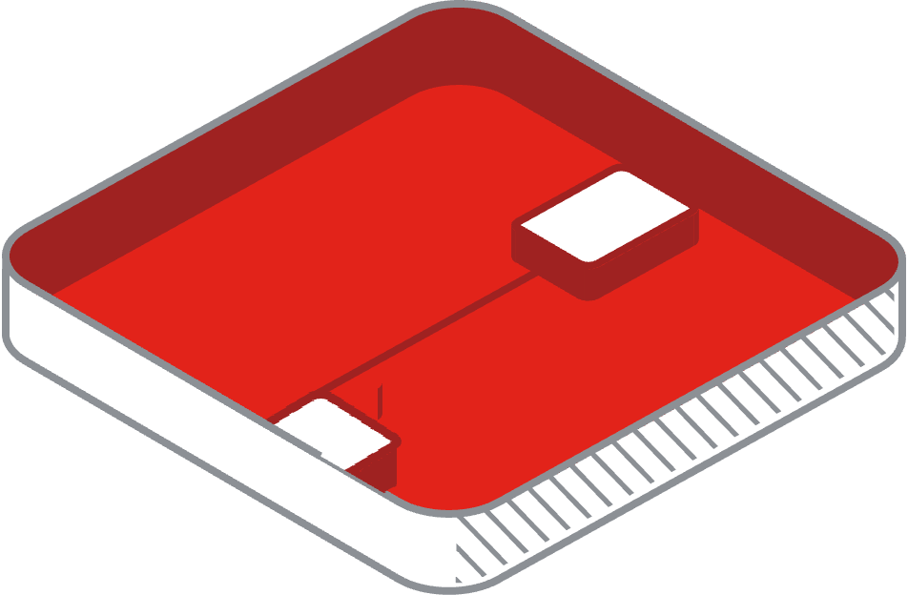
Use Case Full–Stack Visibility
SaaS
BUSINESS
USER EXPERIENCE
CLOUD PROVIDERS
SaaS
SERVICE PROVIDERS
APPLICATION
COLOCATION
SaaS
INFRASTRUCTURE
SaaS
SaaS
NETWORK
CAMPUS
BRANCH
DATA CENTER
EDGE | IOT & OT
SECURITY
Notes:
Let’s talk about how *Full-Stack Observability* empowers businesses to bridge the gap between application performance and business outcomes.
---
Imagine a tool that gives you complete visibility into your entire application stack—this is where Full-Stack Observability begins. By automatically generating a *Flow Map*, it provides a comprehensive view of your application’s performance. With this map, you can easily identify which components are affected by slow transactions or other issues.
This visual representation allows you to drill down to pinpoint the *root cause* of the problem. Whether it’s a database query taking too long, a third-party service that’s unresponsive, or a bottleneck in the code, you can identify and address the issue efficiently. This is a game-changer for ensuring smooth and reliable application performance while reducing downtime.
---
Now let’s take it a step further by connecting technical performance to *business context*—this is the real power of Full-Stack Observability.
- We start with *Full-Stack Visibility*: This layer continuously monitors the entire application ecosystem. As shown in the visual, we can detect anomalies—marked here as red dots—that indicate performance issues. These red flags guide us to areas of concern that need immediate attention.
- Moving to *Full-Stack Insights, we extract meaningful context from this visibility. For example, if there’s an issue with logging into the supplier portal or confirming a delivery, we link this back to its potential business impact. These insights highlight how technical issues can affect business-critical metrics like **revenue, **conversion rates, and the **user journey*.
- Finally, we take *Full-Stack Actions* to address these issues. This could involve API call remediations, optimizing delivery routes, or scaling cloud resources. By prioritizing these actions, we ensure that the most critical problems are resolved first, minimizing business disruption and optimizing costs.
---
In essence, Full-Stack Observability provides an end-to-end approach: identifying issues, contextualizing them with business insights, and enabling data-driven actions to improve performance and outcomes. It’s not just about fixing what’s broken—it’s about ensuring your technology serves your business goals seamlessly and efficiently.

Slide 5

Use Case Full Stack Observability
with Business context
Prioritize issues with Business Context
Full-Stack
Visibility
Full-Stack Insights
Application Business & Experiences
Full-Stack Actions
Remediations & Optimizations
Log in supplier portal
Revenue
Delivery information
App API Call
Remediations
Conversion
Capacity information
3rd Party SaaS service
Delivery Service
Routing Optimization
Delivery confirmation
User journey
Accounts Payable report
Cloud Instance
Scale Down
Full-Stack actions for the business
Notes:
Let’s talk about how *Full-Stack Observability* empowers businesses to bridge the gap between application performance and business outcomes.
---
Imagine a tool that gives you complete visibility into your entire application stack—this is where Full-Stack Observability begins. By automatically generating a *Flow Map*, it provides a comprehensive view of your application’s performance. With this map, you can easily identify which components are affected by slow transactions or other issues.
This visual representation allows you to drill down to pinpoint the *root cause* of the problem. Whether it’s a database query taking too long, a third-party service that’s unresponsive, or a bottleneck in the code, you can identify and address the issue efficiently. This is a game-changer for ensuring smooth and reliable application performance while reducing downtime.
---
Now let’s take it a step further by connecting technical performance to *business context*—this is the real power of Full-Stack Observability.
- We start with *Full-Stack Visibility*: This layer continuously monitors the entire application ecosystem. As shown in the visual, we can detect anomalies—marked here as red dots—that indicate performance issues. These red flags guide us to areas of concern that need immediate attention.
- Moving to *Full-Stack Insights, we extract meaningful context from this visibility. For example, if there’s an issue with logging into the supplier portal or confirming a delivery, we link this back to its potential business impact. These insights highlight how technical issues can affect business-critical metrics like **revenue, **conversion rates, and the **user journey*.
- Finally, we take *Full-Stack Actions* to address these issues. This could involve API call remediations, optimizing delivery routes, or scaling cloud resources. By prioritizing these actions, we ensure that the most critical problems are resolved first, minimizing business disruption and optimizing costs.
---
In essence, Full-Stack Observability provides an end-to-end approach: identifying issues, contextualizing them with business insights, and enabling data-driven actions to improve performance and outcomes. It’s not just about fixing what’s broken—it’s about ensuring your technology serves your business goals seamlessly and efficiently.

Slide 6
Use Case Full Stack Observability
with Business context
Prioritize issues with Business Context
Full-Stack
Visibility
Full-Stack Insights
Application Business & Experiences
Full-Stack Actions
Remediations & Optimizations
Log in supplier portal
Revenue
Delivery information
App API Call
Remediations
Conversion
Capacity information
3rd Party SaaS service
Delivery Service
Routing Optimization
Delivery confirmation
User journey
Accounts Payable report
Cloud Instance
Scale Down
Full-Stack actions for the business
Notes:
Let’s talk about how *Full-Stack Observability* empowers businesses to bridge the gap between application performance and business outcomes.
---
Imagine a tool that gives you complete visibility into your entire application stack—this is where Full-Stack Observability begins. By automatically generating a *Flow Map*, it provides a comprehensive view of your application’s performance. With this map, you can easily identify which components are affected by slow transactions or other issues.
This visual representation allows you to drill down to pinpoint the *root cause* of the problem. Whether it’s a database query taking too long, a third-party service that’s unresponsive, or a bottleneck in the code, you can identify and address the issue efficiently. This is a game-changer for ensuring smooth and reliable application performance while reducing downtime.
---
Now let’s take it a step further by connecting technical performance to *business context*—this is the real power of Full-Stack Observability.
- We start with *Full-Stack Visibility*: This layer continuously monitors the entire application ecosystem. As shown in the visual, we can detect anomalies—marked here as red dots—that indicate performance issues. These red flags guide us to areas of concern that need immediate attention.
- Moving to *Full-Stack Insights, we extract meaningful context from this visibility. For example, if there’s an issue with logging into the supplier portal or confirming a delivery, we link this back to its potential business impact. These insights highlight how technical issues can affect business-critical metrics like **revenue, **conversion rates, and the **user journey*.
- Finally, we take *Full-Stack Actions* to address these issues. This could involve API call remediations, optimizing delivery routes, or scaling cloud resources. By prioritizing these actions, we ensure that the most critical problems are resolved first, minimizing business disruption and optimizing costs.
---
In essence, Full-Stack Observability provides an end-to-end approach: identifying issues, contextualizing them with business insights, and enabling data-driven actions to improve performance and outcomes. It’s not just about fixing what’s broken—it’s about ensuring your technology serves your business goals seamlessly and efficiently.

Slide 7
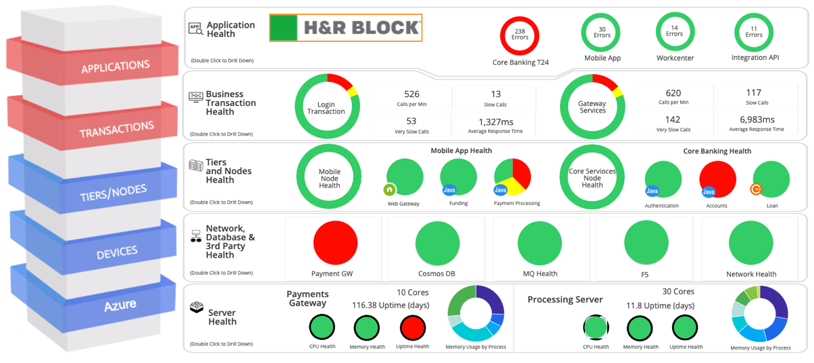

AppDynamics Sample Dashboard
Postal Services
Art of Possible Application and Infrastructure Dashboard:
Dashboard can represent any Application’s Environment
Top to Bottom Application Infrastructure View
Customize based upon customer requirements
Notes:
A custom dashboard enables you to display a specific set of metrics and data points on one screen. You can display application, server, and database metrics reported by Cisco AppDynamics agents. You can also supplement the built-in dashboards (such as the application dashboard, tier dashboard, and so on) and display metrics that are of interest to a particular audience. You can use custom dashboards to present selected metrics for a user who only needs a relatively narrow or focused view of the data.
For example, an executive may only need a high-level view of system performance and activity. You can assign such users to the predefined Custom Dashboard Viewer role. Any user with a custom dashboard viewer role can view custom dashboards.

Slide 8
AppDynamics at Pratt & Whitney

Slide 9
AppDynamics at Pratt & Whitney
Deployed across Quality and production environment across Pratt & Whitney US and Canada
Monitoring business critical application with Pratt & Whitney such as
Solumina
Team Center
Tidal
Kepware
Autoair
Monitoring across Application, infrastructure, Database, network and End user monitoring
Some of primary use-cases are –
Slow Transaction detection
Slow responses on several critical queries
Proactively notification to the teams.
Trace level information and debugging information
Notes:
At Pratt & Whitney, AppDynamics is deployed across both quality and production environments in the US and Canada, monitoring critical business applications like Solumina, Team Center, Tidal, Kepware, and Autoair. It provides comprehensive visibility into application performance, infrastructure, databases, networks, and end-user experience. Key use cases include detecting slow transactions, identifying sluggish query responses, and proactively notifying teams. AppDynamics also delivers trace-level insights and debugging information to help maintain optimal performance and quickly resolve issues.

Slide 10
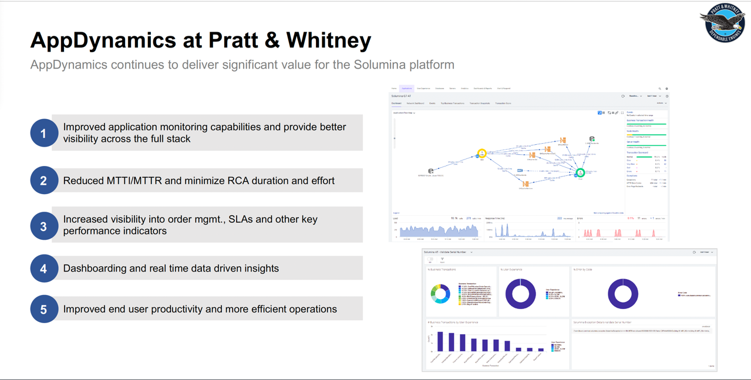
Notes:
AppDynamics at Pratt & Whitney enhances the Solumina platform by improving full-stack application monitoring, reducing Mean Time to Identify/Resolve (MTTI/MTTR), and minimizing Root Cause Analysis (RCA) effort. It boosts visibility into order management, SLAs, and key performance metrics while providing real-time, data-driven insights through dashboards. These capabilities drive improved end-user productivity and operational efficiency.

Slide 11
AppDynamics Agent Licensing Model
AppDynamics offers a diverse licensing model to allow application teams to customize the degree of Application Performance Monitoring that will best suit their needs.
AppDynamics License Types
Application Performance Monitoring (APM)
End-User Monitoring (EUM)
Application Performance Monitoring (APM) provides end-to-end visibility on the application performance. AppD works with popular programming languages such as Java, .NET, Node.js, PHP, Python, C/C++, and more.
Troubleshoot problems such as slow response times and application errors.
Automatically discover application topology
View end to end business transactions performance
Dynamic baselines alert you in the context of business transactions.
End-User Monitoring (EUM) provides end-to-end visibility on the performance of web and mobile applications. EUM provides metrics on application performance and user activity, such as:
How server performance impacts your web and mobile performance
How third-party APIs impact your web and mobile performance
Where your heaviest loads originate
How your users connect to and navigate your application
Database Visibility
Infrastructure Visibility
Database Visibility gives you end-to-end visibility on the performance of your database. Database Visibility provides metrics on database activity, such as:
SQL statements or stored procedures system resource consumption
Statistics on procedures, SQL statements, and SQL query plans
How much time is spent fetching, sorting, or waiting on a lock
Activity from the previous day, week, or month
Infrastructure Visibility gives you end-to-end visibility on the performance of the hardware running your applications. Infrastructure Visibility provides metrics such as:
CPU busy/idle times, disk and partition reads/writes, and network interface utilization (Standalone Machine Agents)
Disk/CPU/memory utilization, process, and machine availability (Server Visibility, additional license required)
Notes:
The Infrastructure-based Licensing model offers license packages for Application Performance Monitoring (APM), End User Monitoring (EUM), Application Analytics, and security. Each package includes a combination of AppDynamics Agents and is based on a single metering unit: CPU Core. Because each agent can pull from a single metering unit, Infrastructure-based Licensing can support diverse applications and provide better license usage estimates.

Slide 12
AppDynamics Kyndryl Team
Q&A
Damian Waid
Service Delivery Manager
Staci Steger
Team Lead/Project Manager
Sayed Rahman
AppDynamics Engineer
Raj Patel
AppDynamics Engineer
John Wannemacher
AppDynamics Engineer
Adam Featherston
AppDynamics Engineer

